Slide 1
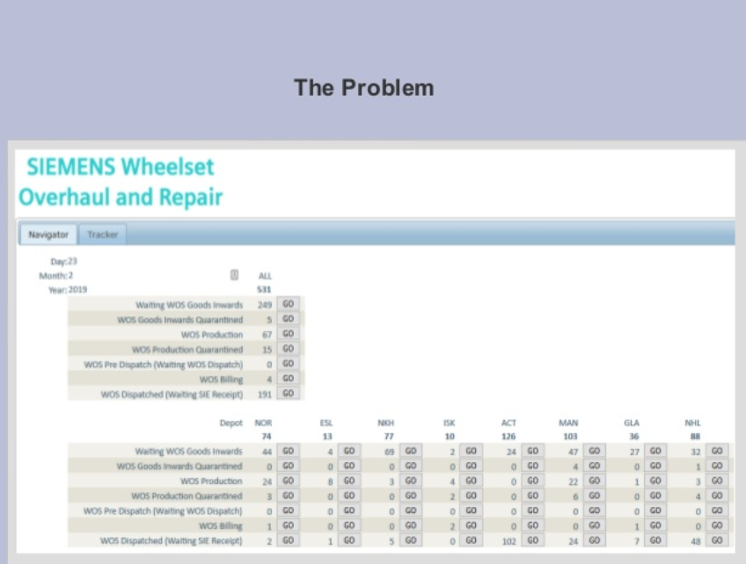
Azure Function and Container Instances
No API
Navigate to the website
Logon
Interact with the page

Slide 2
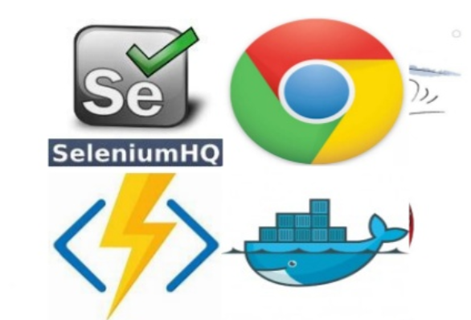
Selenium
Azure functions
Azure SDK in visual studio
Deploy as web service

Slide 3
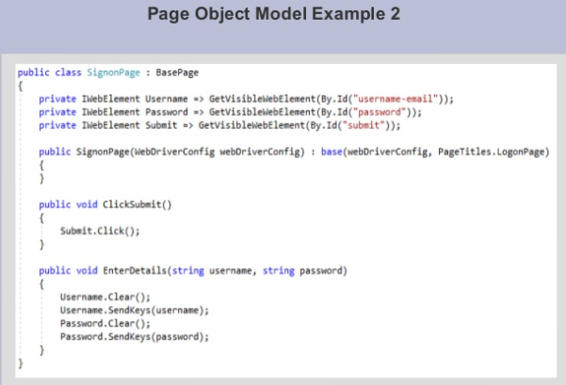
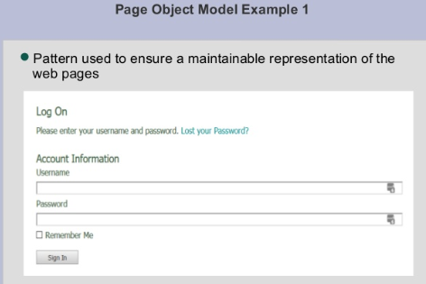
Page Object

Slide 4
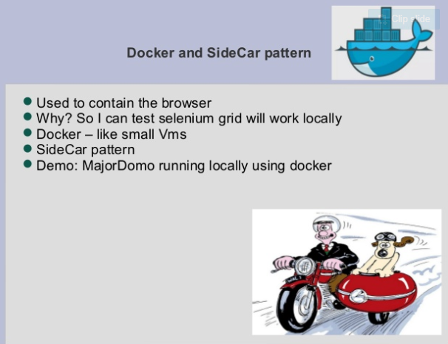
Docker and SideCar Pattern

Slide 5
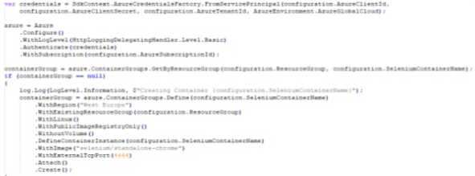
Azure Container Instance
Used to contain the browser in Azure Cloud
Docker image: selenium/standalone-chrome
Startup/Shutdown using Azure libraries

Slide 6
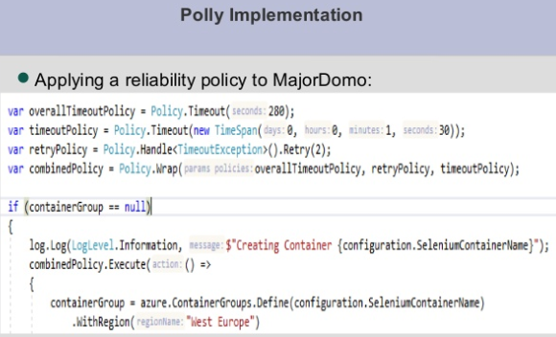
Polly Implementation

Slide 7
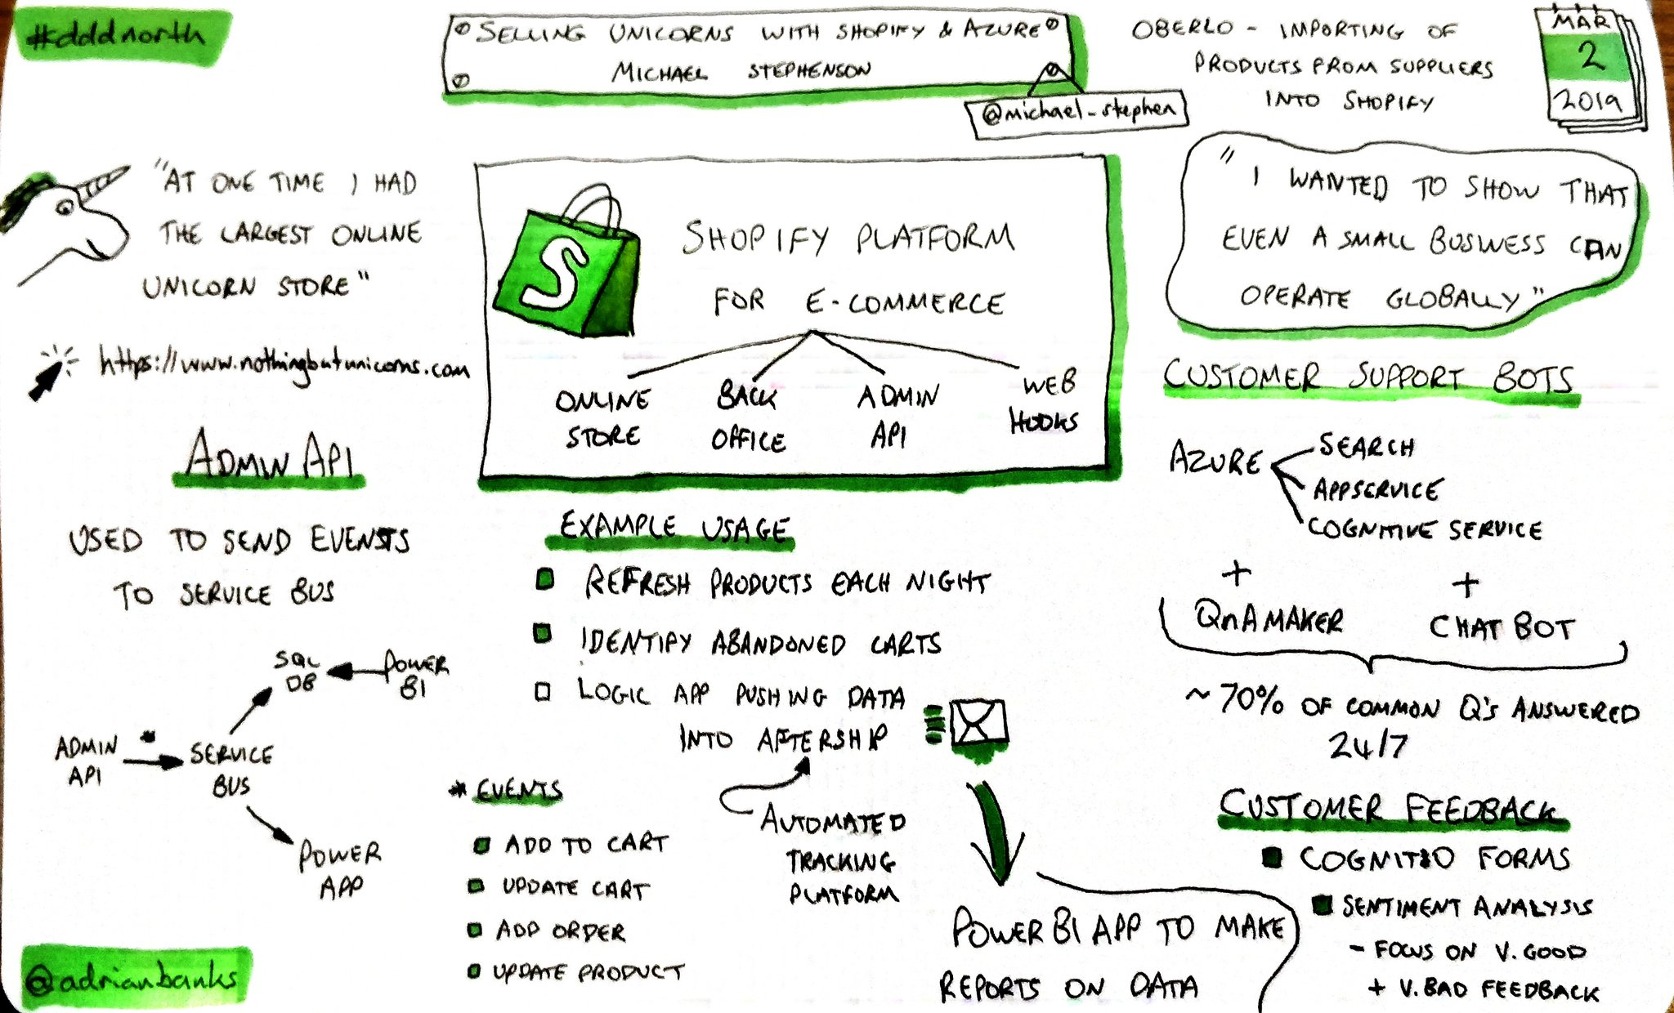
Selling Unicorns with Shopify and Microsoft Azure

